Slide 1
Exceptional Handling in Java
Sonu Sharma
Associate Software Engineer – PSI HQ

Slide 2
What is an Exception?
An Exception is an unwanted event that interrupts the normal flow of the program.
When an exception occurs program execution gets terminated. In such cases we get a system generated error message.
The good thing about exceptions is that they can be handled in Java. By handling the exceptions we can provide a meaningful message to the user about the issue rather than a system generated message, which may not be understandable to a user.
Why an Exception occurs?
There can be several reasons that can cause a program to throw exception.
e.g. : Opening a non-existing file in your program,
Network connection problem, bad input data provided by user etc.

Slide 3
What is an Exception Handling in Java?
The Exception Handling in Java is one of the powerful mechanism to handle the runtime errors so that the normal flow of the application can be maintained.
What are the advantages of Exceptional Handling?
The core advantage of exception handling is to maintain the normal flow of the application.
An exception normally disrupts the normal flow of the application.

Slide 4
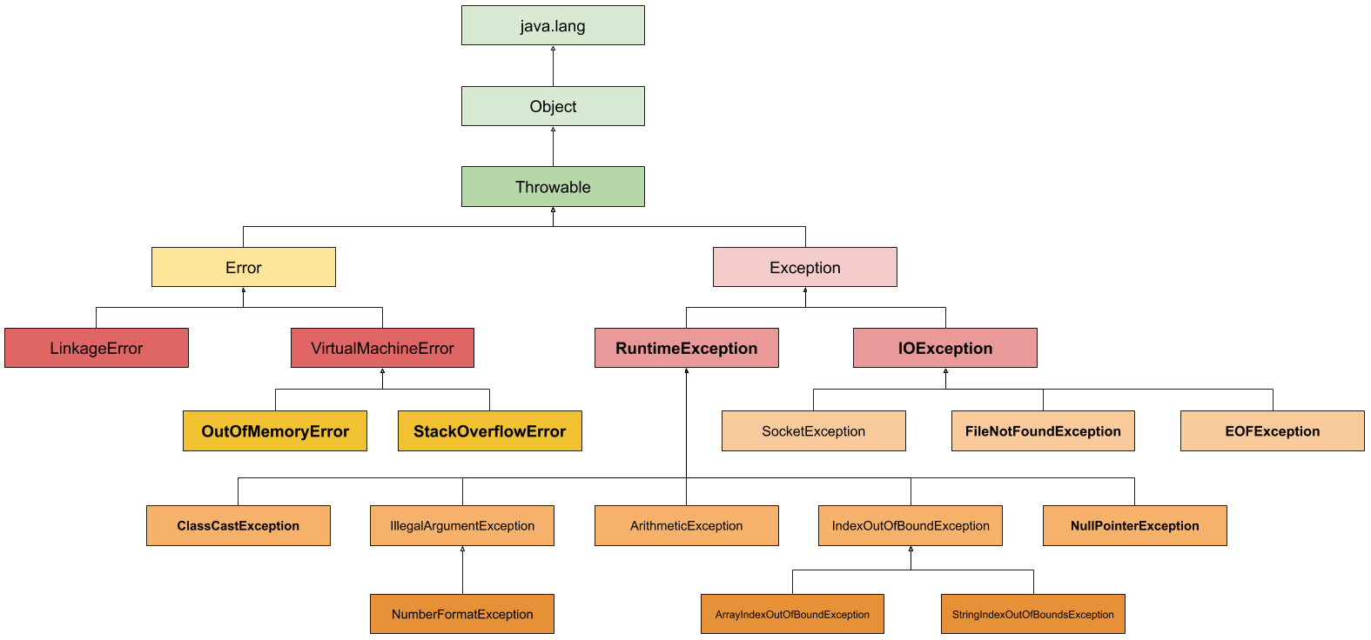
What is an Exception Handling in Java?

Slide 5
Difference b/w Exception and Error
The error indicates a problem that mainly occurs due to the lack of system resources and our application should not catch these types of problems.
Some of the examples of errors are system crash error and out of memory error.
Errors mostly occur at runtime that's they belong to an unchecked type.
Exceptions are the problems which can occur at runtime and compile time.
It mainly occurs in the code written by the developers.
Exceptions are divided into two categories such as checked exceptions and unchecked exceptions.

Slide 6
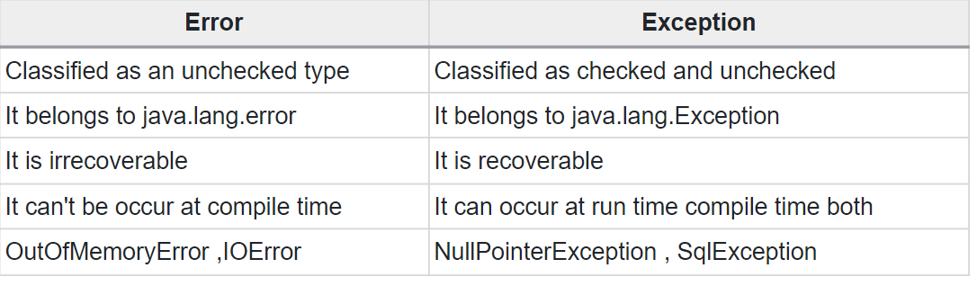
Difference b/w Exception and Error

Slide 7
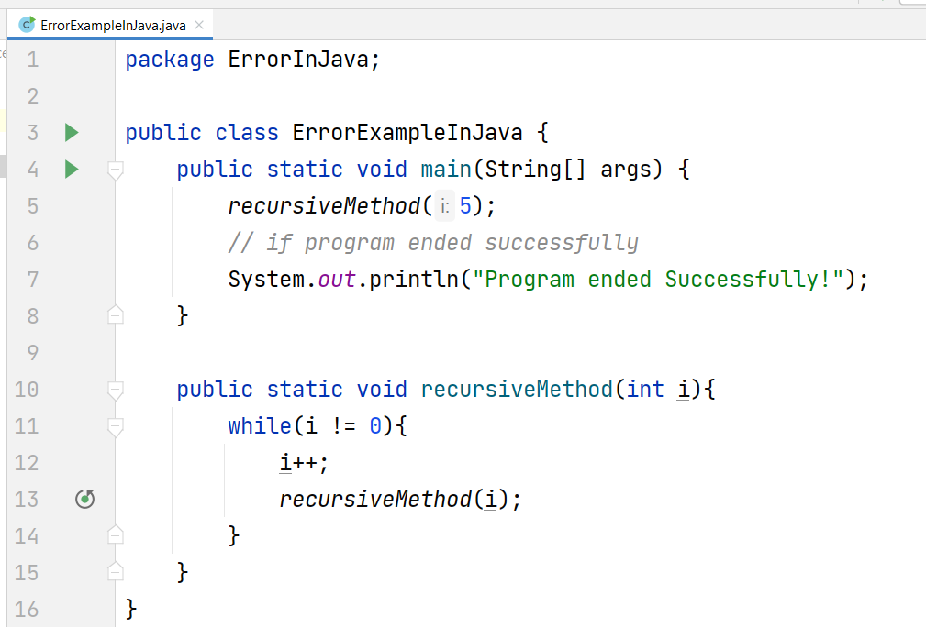
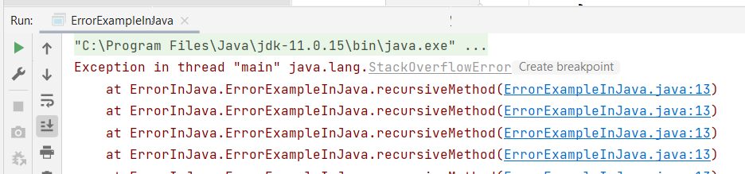
Example of Error in Java

Slide 8
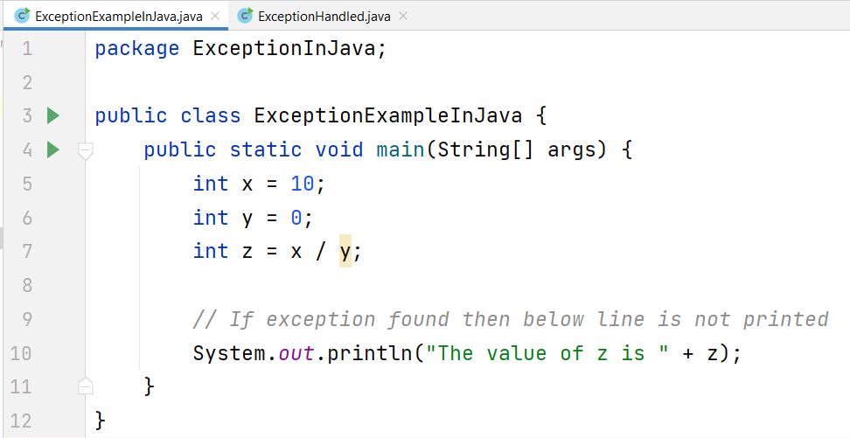
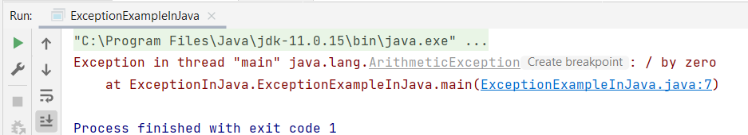
Example of Exception in Java

Slide 9
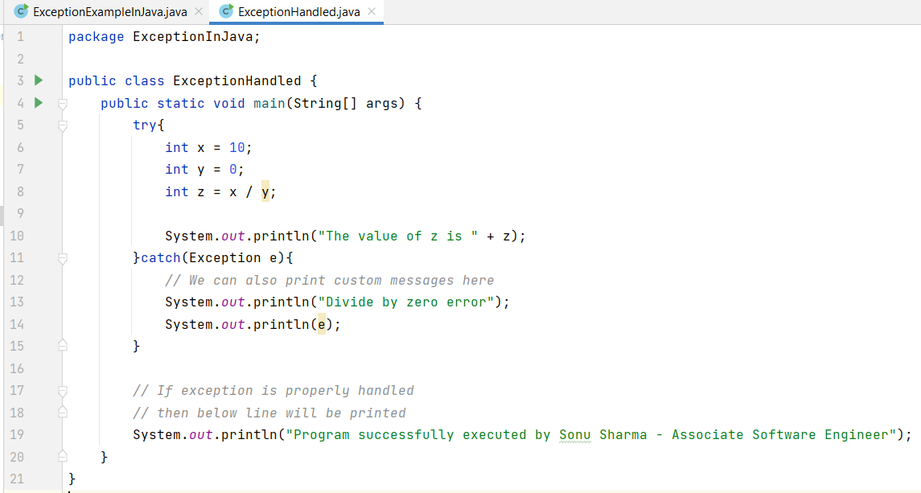
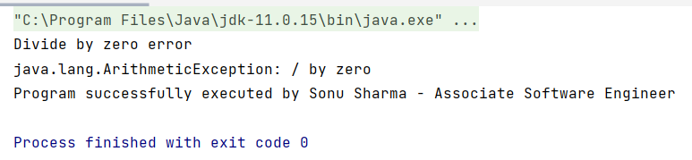
Example of Exception Handling in Java

Slide 10
Checked Exception in Java:
All exceptions other than Runtime Exceptions are known as Checked exceptions as the compiler checks them during compilation to see whether the programmer has handled them or not.
If these exceptions are not handled/declared in the program, you will get compilation error.
For example,
SQLException,
IOException ,
ClassNotFoundException etc.

Slide 11
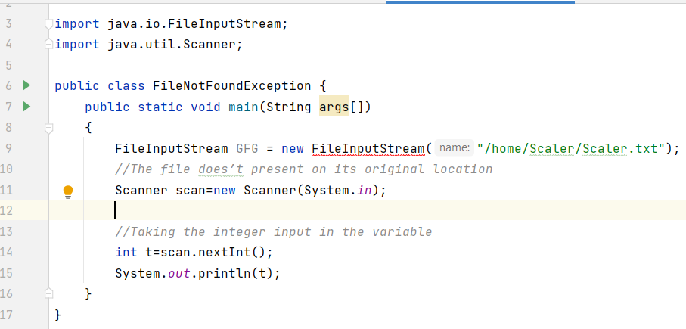
Checked Exception Example:

Slide 12
Unchecked Exception in Java:
Runtime Exceptions are also known as Unchecked Exceptions.
These exceptions are not checked at compile-time so compiler does not check whether the programmer has handled them or not but it’s the responsibility of the programmer to handle these exceptions and provide a safe exit.
For example,
ArithmeticException,
NullPointerException,
ArrayIndexOutOfBoundsException etc.

Slide 13
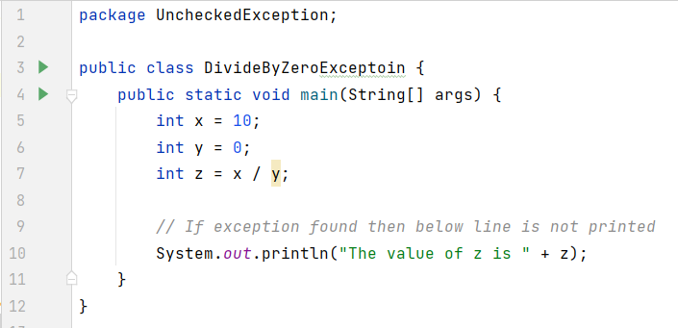
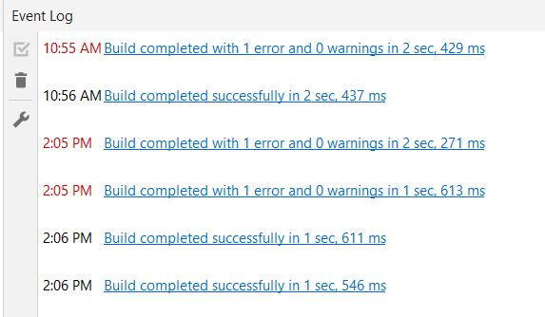
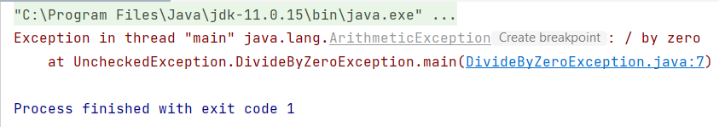
Unchecked Exception Example:

Slide 14
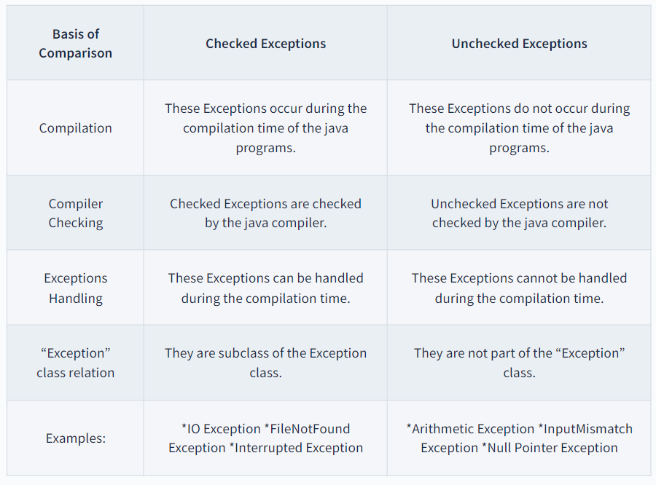
Checked vs Unchecked Exception:

Slide 15
Custom Exception in Java
In Java, we can create our own exceptions that are derived classes of the Exception class.
Creating our own Exception is known as custom exception or user-defined exception.
Basically, Java custom exceptions are used to customize the exception according to user need.
Using the custom exception, we can have your own exception and message.

Slide 16
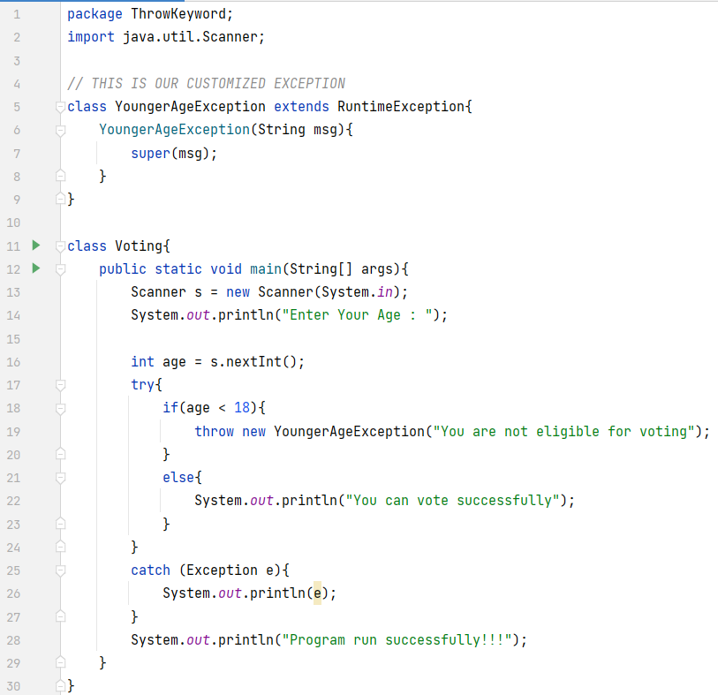
Custom Exception in Java using throw keyword:-

Slide 17
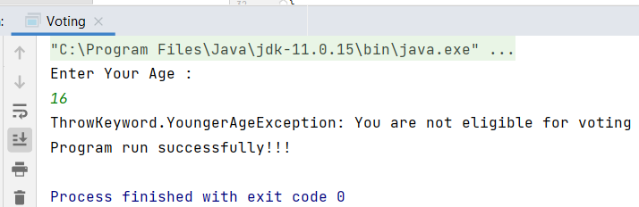
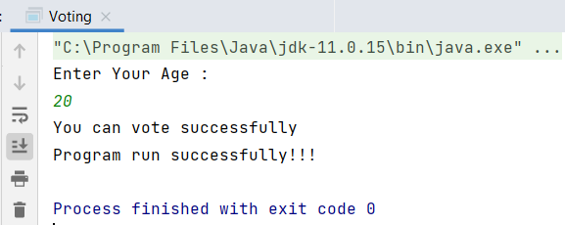
Output :

Slide 18
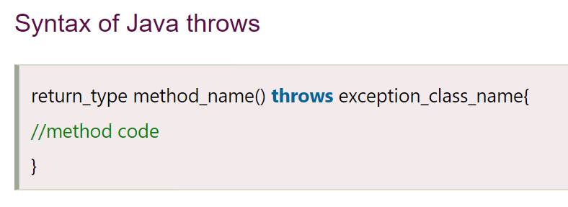
Throws Keyword:
The Java throws keyword is used to declare an exception.
It gives an information to the programmer that there may occur an exception.
So, it is better for the programmer to provide the exception handling code so that the normal flow of the program can be maintained.
Exception Handling is mainly used to handle the checked exceptions.

Slide 19
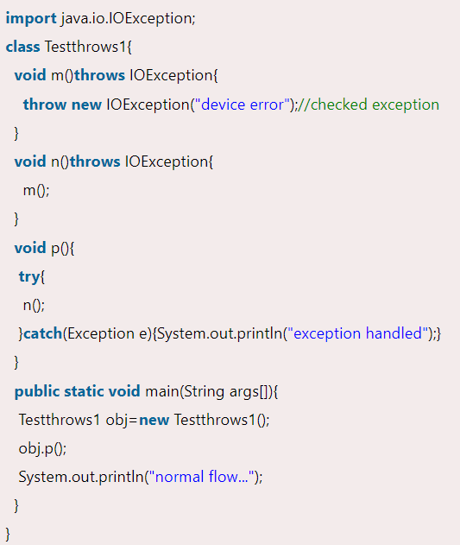
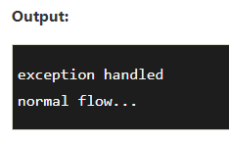
Throws Keyword Example:

Slide 20
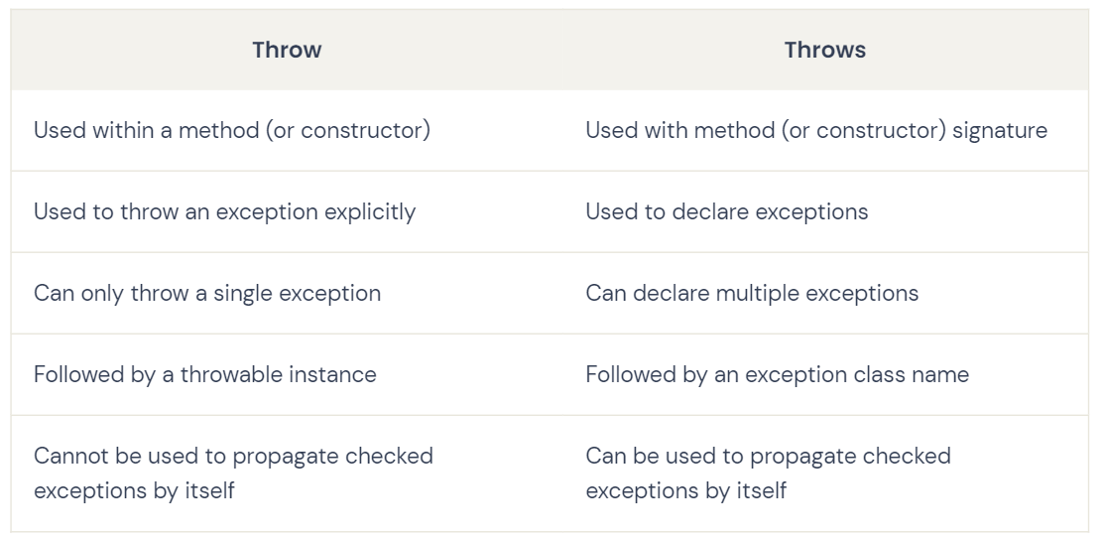
Throw vs Throws keyword

Slide 21
Thank you :)
Sonu Sharma
Associate Software Engineer – PSI HQ

